Slide 1
Data Cleaning/Management Tips
Megan Denver/Greg Zimmerman
CRL & LVDL Meeting, 11/4/25
Slides available online:
https://megandenver.net/slides

Slide 2

Why This Topic?
Organization and transparency improve research
Research workflow = process of conducting research from conceptualization to dissemination
Everyone has a workflow

Slide 3
Why This Topic?
Problems when your workflow is…
Missing key pieces
Inconsistent across projects
Inefficient/error-prone
Workflows are reproducible when well-organized.
Who are they for? Future you (revisions; if code is requested), your research team/advisor

Slide 4
How Do You Stay Organized?
Citation software
Hierarchical folder structures
Consistent/clear naming/label structure
Careful documentation of code (comments, README files, data dictionaries/codebooks)
Knowing the best strategies for handling your data (merging, missingness, identifying duplicates)
Notes:
Readme: project title and description, instructions, any issues to point out and files to use.

Slide 5
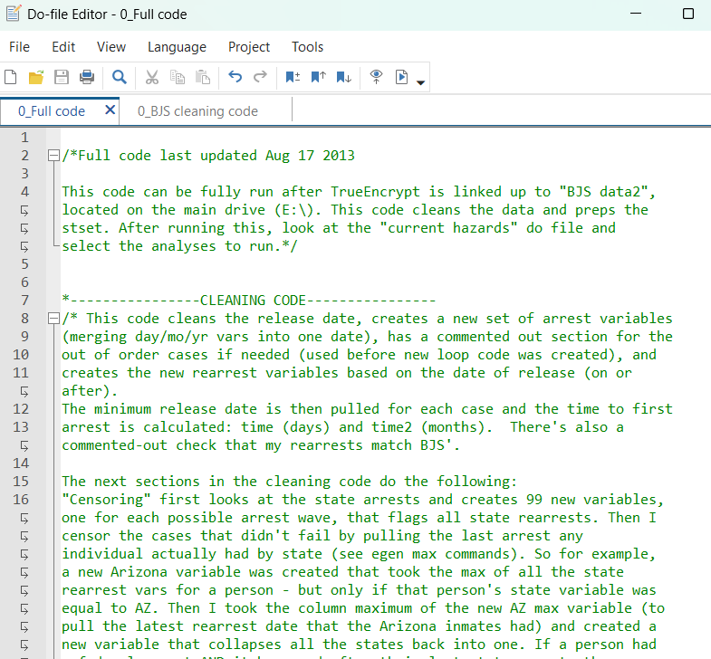
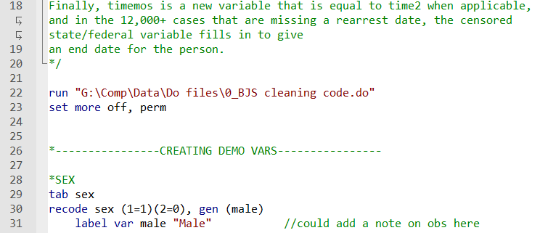
Writing Clean Code (Stata): Comments
/* */ Multi-Line Comments
* Single-Line Comments
// End-of-Line Comments
Notes:
Stata/SE 17 .do file presented here

Slide 6
Writing Clean Code (Stata): Comments
/* */ Multi-Line Comments
* Single-Line Comments
// End-of-Line Comments
Other comment/organizational strategies?

Slide 7
Writing Clean Code (Stata): Loops
The basic idea: condense code to reduce mistakes
When it’s applicable: whenever there’s a pattern
forval: for each value in a variable
foreach: for each variable in a list

Slide 8
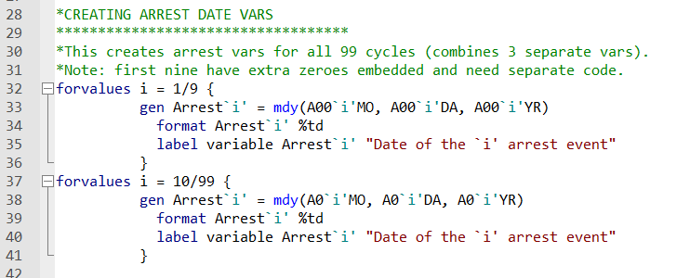
Writing Clean Code (Stata): forval Loops
What is this code doing?

Slide 9

Writing Clean Code (Stata): foreach Loops

Slide 10
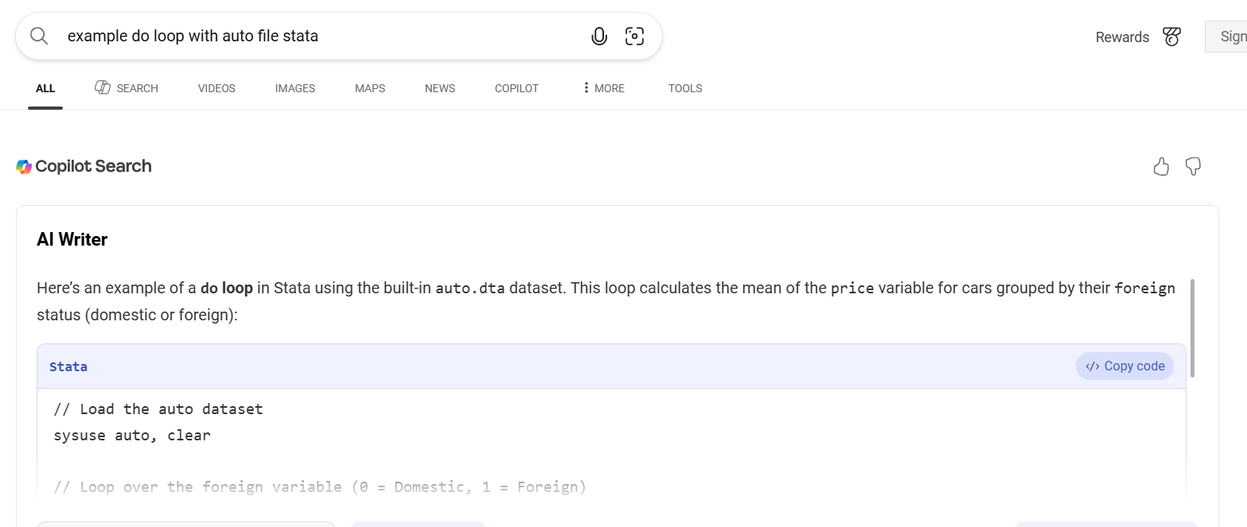
Writing Clean Code (Stata): foreach Loops
Can AI help you write cleaner code?

Slide 11
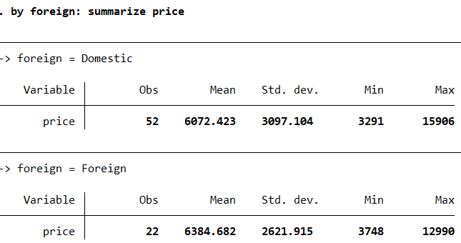
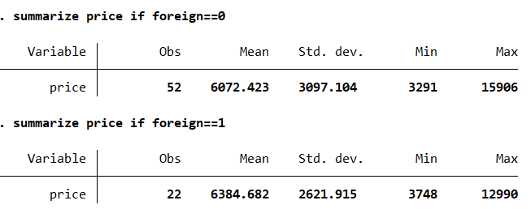
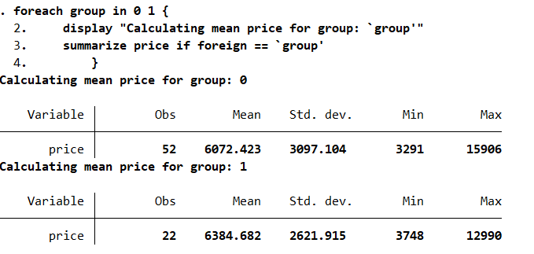
Writing Clean Code (Stata): foreach Loops
Can AI help you write cleaner code?
(sum price for each value of foreign)

Slide 12
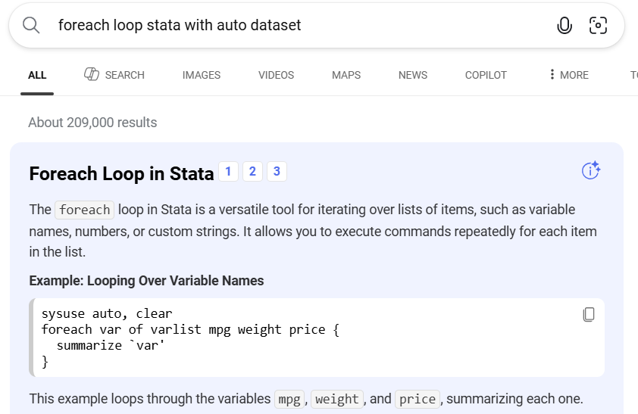
Writing Clean Code (Stata): foreach Loops
Can AI help you write cleaner code?
Technically correct. More efficient code:
summarize var1 var2 var3

